Slide 1




Introduction to the HPC of Faculty IV
Tristan Kreuziger
Remote Sensing Image Analysis (RSiM) Group, TU Berlin
tristan.kreuziger@tu-berlin.de

Slide 2


Info
Hardware:
  40+ Nvidia GPUs (Tesla P100 16GB HBM2)
  Intel Xeon CPUs available
  Details: https://hpc.tu-berlin.de/doku.php?id=hpc:hardware
  Check also the ISIS HPC course for announcements and community support
Access:
  tubIT account needed
  Explicit access has to be granted by members from faculty IV (e.g. RSiM)
Login: ssh <tubIT-Login>@gateway.hpc.tu-berlin.de
From outside the TUB networks:
  Via VPN or
  SSH gate:
    ssh <tubIT-Login>@sshgate.tu-berlin.de
    ssh gateway.hpc.tu-berlin.de
T. Kreuziger
2

Slide 3
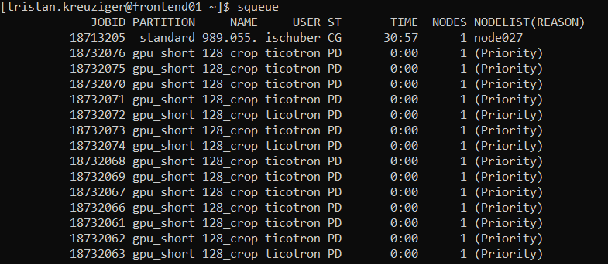
Job Scheduling
Jobs are managed via Slurm (https://slurm.schedmd.com/overview.html)
Check the current status: squeue
Start a new job: srun [parameters] python main.py
Start a bash script as a new job: sbatch [parameters] mybashfile.sh
T. Kreuziger
3

Slide 4
Most important Slurm parameters
-o output file
-D working directory
-J job name
--time expected runtime
--nodes=2 number of nodes
--ntasks-per-node=3 tasks per node
--ntasks-per-core=1 tasks per CPU core
--mem=50G memory per node
--gres=gpu:tesla:2 use two GPUs
--partition=gpu set this, if you need the GPU
Get notified via email:
--mail-type=ALL --mail-user=firstname.lastname@tu-berlin.de
All parameters can be specified on the command line or set in a bash file:
    #!/bin/bash
    #SBATCH -o /../../../myjob.%j.%N.out
    #SBATCH -D /../../../
    #SBATCH -J Hello-World_GPU
    #SBATCH --ntasks=2
    #SBATCH --cpus-per-task=1
    #SBATCH --gres=gpu:tesla:2
    #SBATCH --mem=500G
T. Kreuziger
4

Slide 5
Using the GPUs for TensorFlow / PyTorch / ...
Enable Python:
  module load python/3.6.7
  module load python/3.6.7_tf_2.1.0
  module load python/3.6.8_tf-gpu
If you need additional packages, create a virtual environment in the frontend and activate it at the beginning of the job:
    source /home/users/t/tristan.kreuziger/venv/bin/activate
  Enable GPU support by loading modules (different versions are available, check logs, which one you need):
  module load nvidia/cuda/10.0
  module load nvidia/cuda/10.1
  module load nvidia/cuda/9.0
T. Kreuziger
5

Slide 6
Full GPU job example
mybashfile.sh
  #!/bin/bash
  #SBATCH -o /home/users/t/tristan.kreuziger/log.out
  #SBATCH -J test-distributed-training
  #SBATCH --ntasks=2
  #SBATCH --cpus-per-task=4
  #SBATCH --gres=gpu:tesla:2
  #SBATCH --mem=50G
  #SBATCH --partition=gpu
  source /home/users/t/tristan.kreuziger/venv/bin/activate
  module load nvidia/cuda/10.0
  python -m main
Then start it with: sbatch mybashfile.sh
T. Kreuziger
6

Slide 7
Step-by-step
Start your job with srun or sbatch.
Check, if your job has started by running squeue. If it has started, you can connect with it.
Connect with the node, where your job is running:
  ➔ ssh node027
Check the status on the node via htop or nvidia-smi.
Follow the output of your job: tail –f <YOUR_OUTPUT_FILE>
T. Kreuziger
7

Slide 8
Some useful Slurm commands
Interactive shell:
srun --pty /bin/bash
Filter the queue for your submitted job:
squeue | grep <tubIT-Login>
Display the status of the node:
sinfo
Cancel a submitted/running job:
scancel <ID>
Start a job later:
sbatch --begin=16:00 […] mybashfile.sh
Start a job depending on other jobs (other options available):
sbatch --dependency=afterok:11254323 mybashfile2.sh
There are many more options, check the Slurm documentation.
T. Kreuziger
8

Slide 9


Thank you for your attention!

